Slide 1
DEPARTMENT OF BCA
FUNDAMENTALS OF MATHEMATICS
MODULE-1
MATRIX THEORY

Slide 2
Elementary Row Operations or Transformation:-
The elementary row operation or transformation of a matrix,
Inter Change of any two rows
Multiplication of any one of the rows by a nonzero scalar
Addition ( substraction) of any two rows by which any one of the row can be multiplied by non zero scalar.
Symbolically denoted by Ri ↔Rj
Ri ↔ KRi
Ri ↔ Ri + KRj

Slide 3
Row Equivalent matrices:-
Two matrices A and B are said to be row equivalent or simply equivalent.
If one matrix is obtained by means of the elementary operations.
It is denoted by A ~ B .

Slide 4
ROW REDUCED ECHELON FORM
Echelon form means that the matrix is in one of two states:
Row echelon form.
Reduced row echelon form.
This means that the matrix meets the following three requirements:
The first number in the row (called a leading entry) is 1.
All the entries below the leading entry should be zero.
The number of zeros before the leading entry should equal to more than the previous row.
Any non-zero rows are always above rows with all zeros.

Slide 5

ROW REDUCED ECHELON FORM
Example: Consider
$$\begin{matrix}\begin{aligned}A=\left(\begin{matrix}1 & 2 & −1 & 4 \\ 2 & 4 & 3 & 5 \\ 3 & 2 & 5 & 8\end{matrix}\right)\frac{R2→R2−2R1}{R3→R3−3R1}→\left(\begin{matrix}1 & 2 & −1 & 4 \\ 0 & 0 & 5 & −3 \\ 0 & −4 & 8 & −4\end{matrix}\right)\frac{R2↔R3}{}→ \\ \\ \end{aligned} \\ \begin{aligned}\left(\begin{matrix}1 & 2 & −1 & 4 \\ 0 & −4 & 8 & −4 \\ 0 & 0 & 5 & −3\end{matrix}\right)\frac{R2→R2/−4}{}→\left(\begin{matrix}1 & 2 & −1 & 4 \\ 0 & 1 & 2 & 1 \\ 0 & 0 & 5 & −3\end{matrix}\right)\frac{R2→R2/5}{}→ \\ \end{aligned} \\ \left(\begin{matrix}1 & 2 & −1 & 4 \\ 0 & 1 & 2 & 1 \\ 0 & 0 & 1 & −3/5\end{matrix}\right)\end{matrix}$$

Slide 6
RANK OF THE MATRIX
Rank of the matrix A is defined as the number of non zero rows in the row reduced echelon form of the given matrix A. It is denoted by the symbol ρ(A).
In the before stated example, the number of nonzero rows in the row reduced echelon form of A is 3. Thus ρ(A)=3

Slide 7
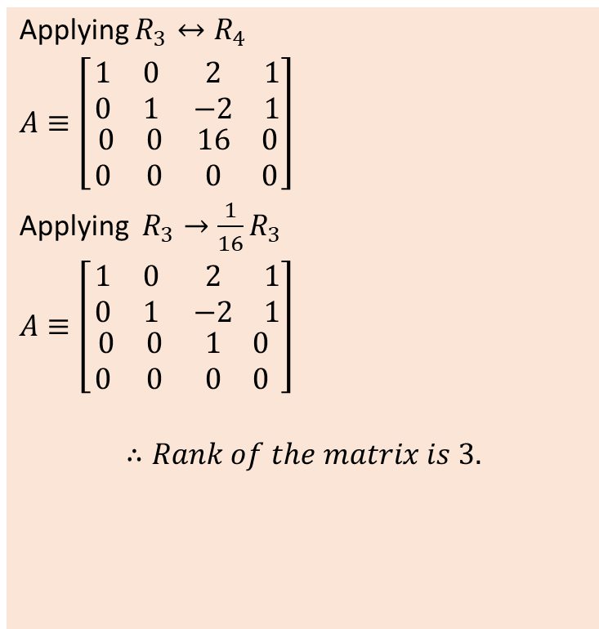
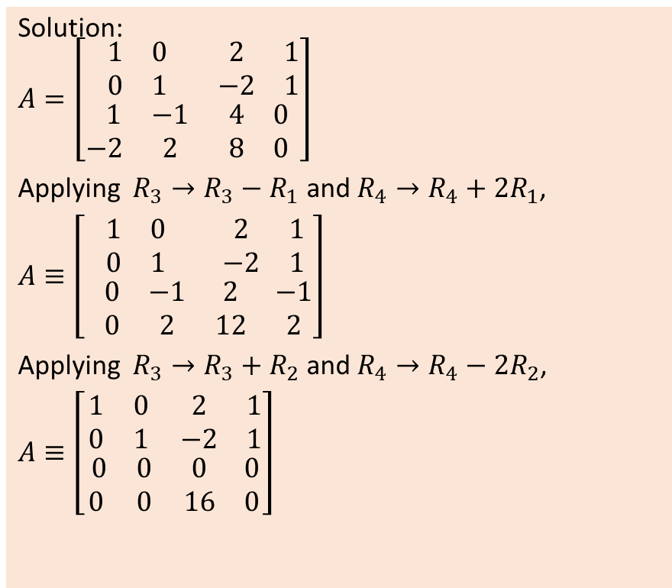
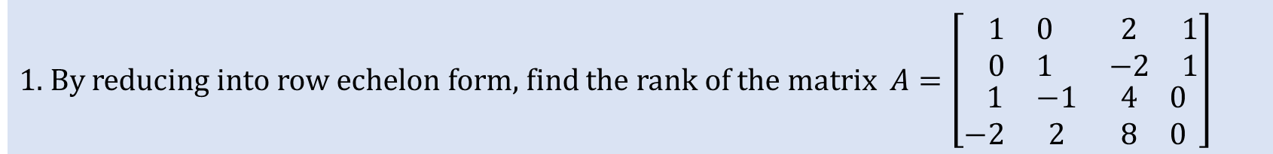
1. By reducing into row echelon form, find the rank of the matrix $A=\left[\begin{matrix}\begin{matrix}1 & 0 \\ 0 & 1\end{matrix} & \begin{matrix}2 & 1 \\ −2 & 1\end{matrix} \\ \begin{matrix} 1 & −1 \\ −2 & 2\end{matrix} & \begin{matrix}4 & 0 \\ 8 & 0\end{matrix}\end{matrix}\right]$
Solution:
$$A=\left[\begin{matrix}\begin{matrix}1 & 0 \\ 0 & 1\end{matrix} & \begin{matrix}2 & 1 \\ −2 & 1\end{matrix} \\ \begin{matrix} 1 & −1 \\ −2 & 2\end{matrix} & \begin{matrix}4 & 0 \\ 8 & 0\end{matrix}\end{matrix}\right]$$
Applying $R_{3}→R_{3}−R_{1}$ and $R_{4}→R_{4}+2R_{1}$,
$A≡$ $\left[\begin{matrix}\begin{matrix}1 & 0 \\ 0 & 1\end{matrix} & \begin{matrix}2 & 1 \\ −2 & 1\end{matrix} \\ \begin{matrix} 0 & −1 \\ 0 & 2\end{matrix} & \begin{matrix}2 & −1 \\ 12 & 2\end{matrix}\end{matrix}\right]$
Applying $R_{3}→R_{3}+R_{2}$ and $R_{4}→R_{4}−2R_{2}$,
$A≡$ $\left[\begin{matrix}\begin{matrix}1 & 0 \\ 0 & 1\end{matrix} & \begin{matrix}2 & 1 \\ −2 & 1\end{matrix} \\ \begin{matrix} 0 & 0 \\ 0 & 0\end{matrix} & \begin{matrix}0 & 0 \\ 16 & 0\end{matrix}\end{matrix}\right]$
Applying $R_{3}↔R_{4}$
$A≡$ $\left[\begin{matrix}\begin{matrix}1 & 0 \\ 0 & 1\end{matrix} & \begin{matrix}2 & 1 \\ −2 & 1\end{matrix} \\ \begin{matrix} 0 & 0 \\ 0 & 0\end{matrix} & \begin{matrix}16 & 0 \\ 0 & 0\end{matrix}\end{matrix}\right]$
Applying $R_{3}→\frac{1}{16}R_{3}$
$A≡$ $\left[\begin{matrix}\begin{matrix}1 & 0 \\ 0 & 1\end{matrix} & \begin{matrix}2 & 1 \\ −2 & 1\end{matrix} \\ \begin{matrix} 0 & 0 \\ 0 & 0\end{matrix} & \begin{matrix}1 & 0 \\ 0 & 0\end{matrix}\end{matrix}\right]$
$$∴Rank of the matrix is 3.$$

Slide 8
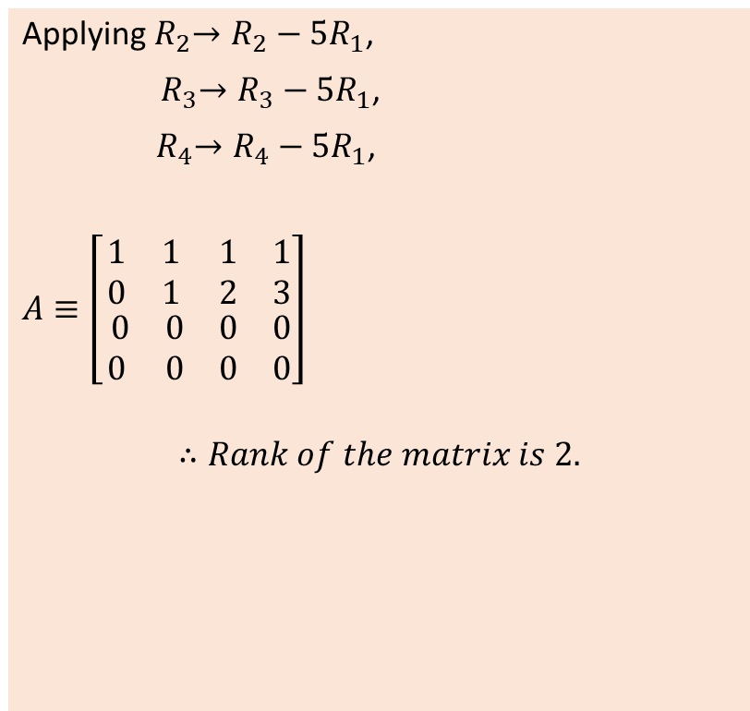
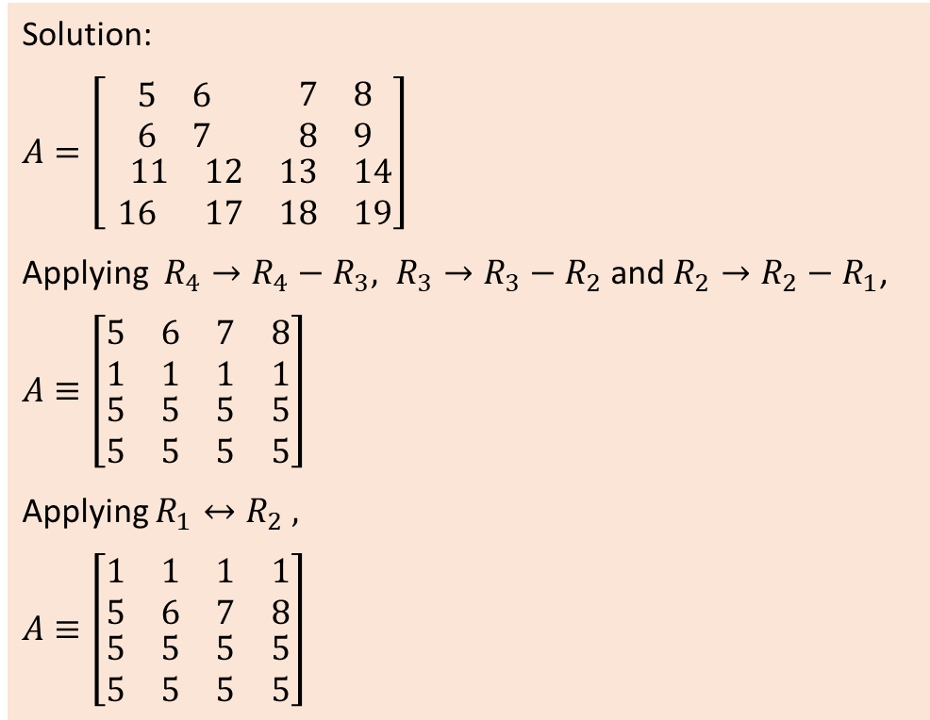
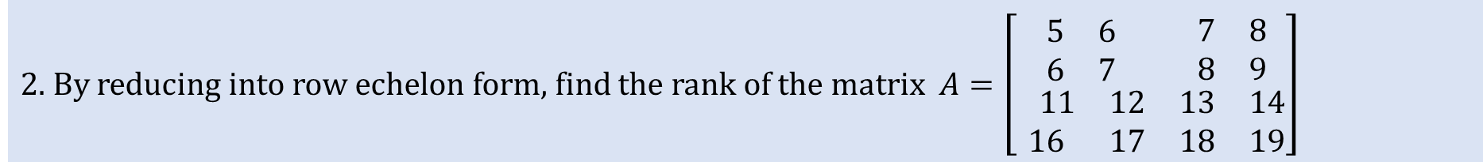
2. By reducing into row echelon form, find the rank of the matrix $A=\left[\begin{matrix}\begin{matrix}5 & 6 \\ 6 & 7\end{matrix} & \begin{matrix}7 & 8 \\ 8 & 9\end{matrix} \\ \begin{matrix} 11 & 12 \\ 16 & 17\end{matrix} & \begin{matrix}13 & 14 \\ 18 & 19\end{matrix}\end{matrix}\right]$
Solution:
$$A=\left[\begin{matrix}\begin{matrix}5 & 6 \\ 6 & 7\end{matrix} & \begin{matrix}7 & 8 \\ 8 & 9\end{matrix} \\ \begin{matrix} 11 & 12 \\ 16 & 17\end{matrix} & \begin{matrix}13 & 14 \\ 18 & 19\end{matrix}\end{matrix}\right]$$
Applying ${R_{4}→R_{4}−R_{3}, R}_{3}→R_{3}−R_{2}$ and $R_{2}→R_{2}−R_{1}$,
$$A≡\left[\begin{matrix}\begin{matrix}5 & 6 \\ 1 & 1\end{matrix} & \begin{matrix}7 & 8 \\ 1 & 1\end{matrix} \\ \begin{matrix}5 & 5 \\ 5 & 5\end{matrix} & \begin{matrix}5 & 5 \\ 5 & 5\end{matrix}\end{matrix}\right]$$
Applying $R_{1}↔R_{2} ,$
$$A≡\left[\begin{matrix}\begin{matrix}1 & 1 \\ 5 & 6\end{matrix} & \begin{matrix}1 & 1 \\ 7 & 8\end{matrix} \\ \begin{matrix}5 & 5 \\ 5 & 5\end{matrix} & \begin{matrix}5 & 5 \\ 5 & 5\end{matrix}\end{matrix}\right]$$
Applying${ R}_{2}→R_{2}−{5R}_{1}$,
${ R}_{3}→R_{3}−{5R}_{1}$,
${ R}_{4}→R_{4}−{5R}_{1}$,
$A≡$ $\left[\begin{matrix}\begin{matrix}1 & 1 \\ 0 & 1\end{matrix} & \begin{matrix}1 & 1 \\ 2 & 3\end{matrix} \\ \begin{matrix} 0 & 0 \\ 0 & 0\end{matrix} & \begin{matrix}0 & 0 \\ 0 & 0\end{matrix}\end{matrix}\right]$
$$∴Rank of the matrix is 2.$$

Slide 9
THANK YOU

